Slide 1
Generics in .NET
Joe Wirtley @JoeWirtley

Slide 2

About Me
Wirtley Consulting LLC
Springboro, OH
Dayton .NET Developer Group
C#, WPF, MVC, Web API
@JoeWirtley

Slide 3
Outline
Basics
Constraints
Generics in action
Other topics

Slide 4

When to Use
Code the same except for type
When you are typecasting

Slide 5
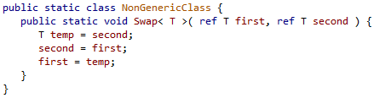
Method

Slide 6
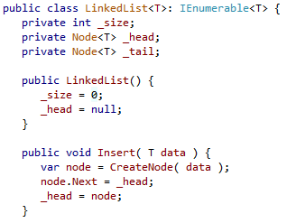
Classes and Interfaces

Slide 7
Delegates

Slide 8
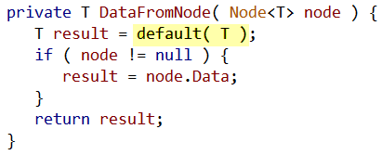
Default

Slide 9
Basic Example

Slide 10
Constraints
Restricts types that can be used in a generic
On class or method
Three types
Reference/Value
Type
New

Slide 11
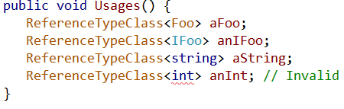
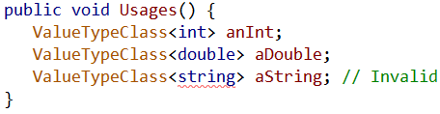
Reference/Value Constraints

Slide 12
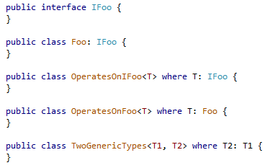
Type Constraints

Slide 13
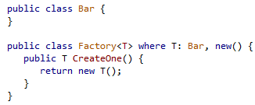
New Constraint

Slide 14
Unconstrained Type Parameters
Cannot use == and != operators
Can be converted to and from classes or interfaces
Can compare to null

Slide 15
When constrained to class
Use == and != with caution
Only does reference comparison
See UnconstrainedTests in sample code

Slide 16

IEnumerable Cast

Slide 17
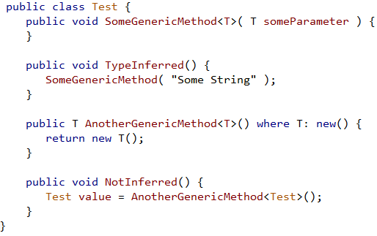
Type Inference

Slide 18
Real World Examples
Serialization
Finder Tab
Chart
Filtering

Slide 19
Enum
Can’t write a constraint to an Enum
Constrain to struct, IConvertible
Check for typeof(type).IsEnum
Not compile time safe

Slide 20

Covariance/Contravariance
Permits child child to be used in place of parent classes.
Introduced with .NET 4

Slide 21
Terminology
An unbound type has no type arguments specified
A constructed type has at least one type argument specified
A type parameter is an open type
An open constructed type has at least one type argument which is an open type
A closed type is any type which isn't open
John Skeet http://bit.ly.com/GEN-Terms

Slide 22
Reflection
Type.IsGenericType
Interrogate
Create

Slide 23
Contact Me
GitHub: https://bit.ly/GenericsInNET
Joe@WirtleyConsulting.com
@JoeWirtley
http://WirtleyConsulting.com
Friday 8:30 Indigo Bay Attack of the Clones: Eliminating Duplicate Code in .NET

